Slide 1


ArcGIS API for JavaScript: Using Arcade with your Apps
Kristian Ekenes & David Bayer
2018 Esri DEVSummit Conference | Palm Springs, CA

Slide 2


Session Goals
Overview of Arcade
What is Arcade
Why use Arcade
Arcade Language
Variables, Functions, Loops, Conditional Statements
Arcade and the ESRI JavaScript API
Using Arcade in Custom Apps

Slide 3
A new expression language for the ArcGIS Platform
ArcGIS Pro
Runtime SDKs
JavaScript API
Web apps
Primarily designed for ArcGIS web maps and web scenes
What is Arcade?

Slide 4
Arcade Purpose
Arcade is NOT intended to be a Full Programming / Scripting Language
Goal : Lightweight and Simple
Equivalent to a Spreadsheet Cell Calculation
Embedded Expressions
Labeling, Rendering, Symbol Variation, ….
Sharing
Not a replacement for Python for geoprocessing and Automation
Input Values
Arcade
Expression
Result Value

Slide 5

Hello World
And a few more examples…

Slide 6


Why is it called Arcade?

Slide 7
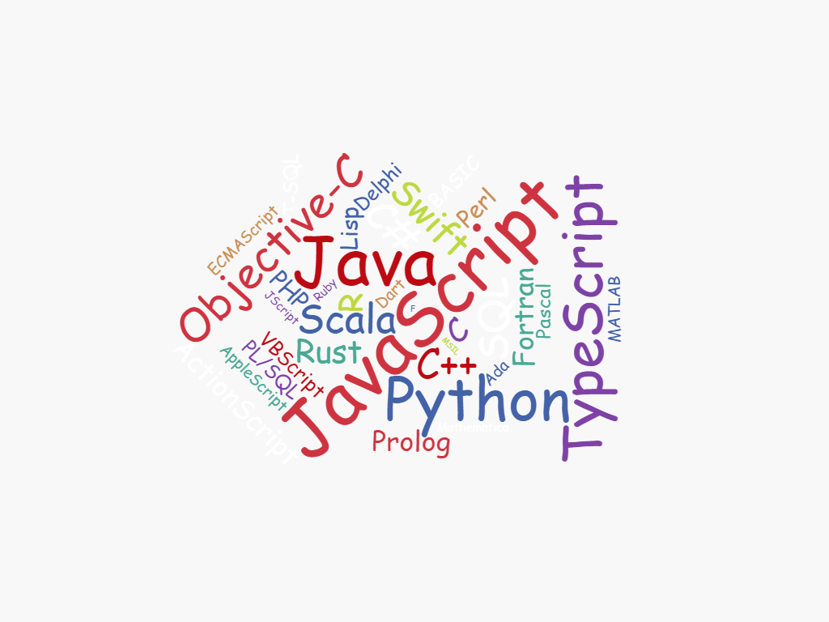
Why do I need another language?

Slide 8
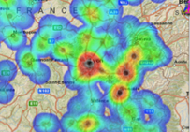
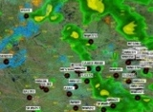
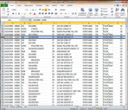
ArcGIS: Make, Share, Anywhere

Slide 9


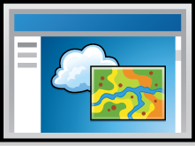
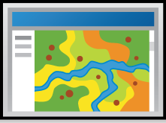
ArcGIS Environments and Platforms
Smart Phones
Social Media
Tablets
Web Sites
Desktop
Browsers

Slide 10



ArcGIS: Make, Share, Anywhere - Challenges
Traditional Development / Scripting Languages
Browser based Apps
Mobile and Native Apps
Size of Executable
Security
Native Access
Page Size
Security
XSS
No Binaries

Slide 11
Arcade Goals
Portable
Write an Expression in Pro, have it run in a Browser, or on a Device
Secure
Ensure that Expressions or Scripting do not compromise Security
Lightweight
Most requirements for Scripts and Expressions are Lightweight. The language should be small, and fast
Geospatial
Scripts should treat Geospatial as First Class Members

Slide 12
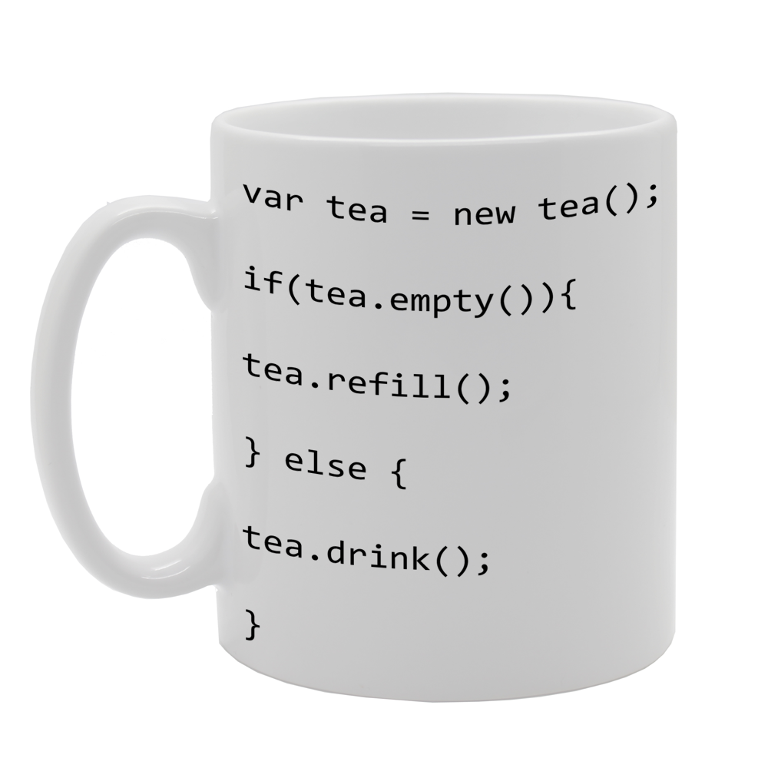
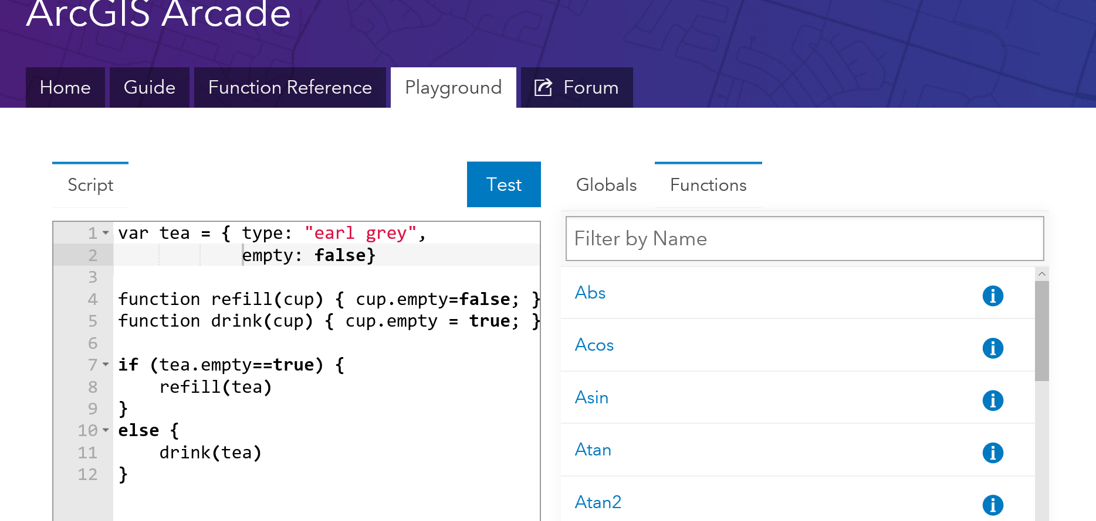
What can I do with it?

Slide 13

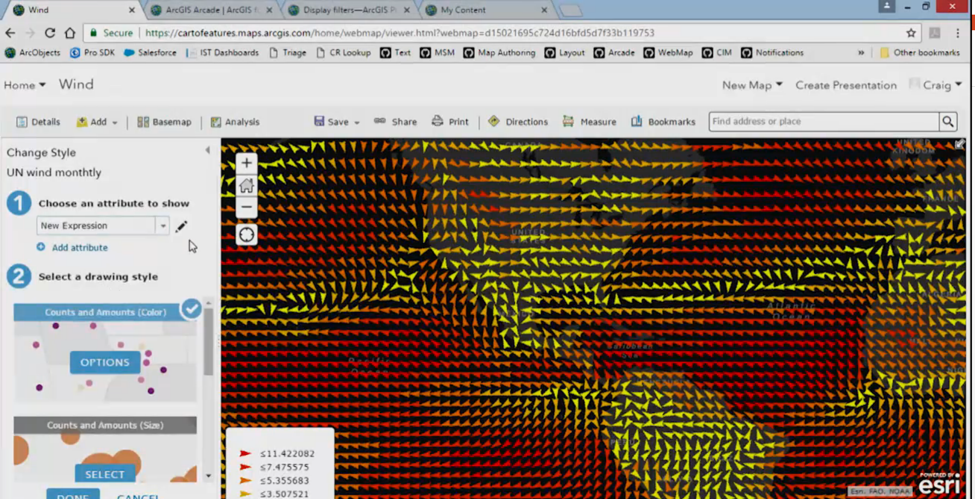
Arcade examples

Slide 14
Language Overview
Type System
Flow Control
Statements
Functions
Statements
and Operators

Slide 15
Arcade : Language Features
Designed for Simple Expressions
Single Line - Implicit Returns
Case Insensitive Language
Dictionary Syntax for Field Access
Has Language Features to Support more Complex Scripts
Type System
Implicit and Explicit Type Casting
Flow Control Statements: IF, FOR
Variable Declaration and Assignments
User Defined Functions
Arcade Scripts run and return a value. They are self contained and cannot alter their environment.

Slide 16
Implicit Returns
(10 + 100) * 30
Equivalent to:
return (10 + 100) * 30;
Implicit Returns
Last executable statement that is a value, will automatically be considered the return value.
Enables very simple Single Line Expressions

Slide 17
Case Insensitive
UpPeR(“Hello”)
$FeAtUrE.FiElD1
Language is Case Insensitive
Quicker to Author
Simpler for working with Data, and Field Names

Slide 18
Functions
Data Functions
Dictionary
DomainCode
DomainName
Feature
First
HasKey
IndexOf
Reverse
Sort
TypeOf
Date Functions
Date
DateAdd
DateDiff
Millisecond
Minute
Hour
Month
Weekday
Year
Day
Now
Today
Geometry Functions
Geometry
Multipoint
Extent
Polyline
Polygon
Logical Functions
IsEmpty
DefaultValue
When
Decode
Iif
Boolean
Mathematical Functions
Abs
Acos
Asin
Atan
Atan2
Average
Ceil
Cos
Count
Exp
Floor
Log
Min
Max
Number
Pow
Random
Round
Text Functions
Concatenate
Console
Find
Lower
Left
Mid
Proper
Replace
Right
Split
Text
Trim
Upper
Sin
Sqrt
Stdev
Sum
Tan
Variance
“
Functions are the Power of Arcade

Slide 19

Global Variables and Profiles
Labeling
Rendering
Use Expressions to provide values required for different types of Renderers
Global Variables
$feature
$view
Use Expressions to provide values required for different types of Renderers
Global Variables
$feature
$view
Future Profiles
“
Profiles provide the purpose for executing an Arcade Expression

Slide 20
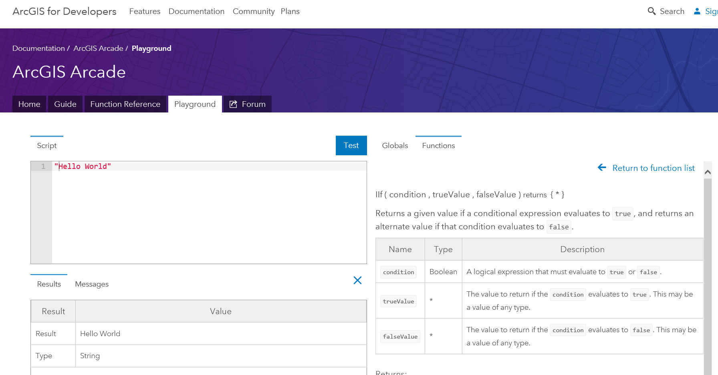
Exploring Profiles and Functions in the Playground

Slide 21
Type System
Simple Types
Numbers
Booleans
Dates
Strings
Object Types
Dictionary
Feature
Array
Point
Line
Polygon
Multipoint
var myNumber = 10;
var myText = “Hello”;
var myDate = Date(2015,1,1);
var myBool = true;
var myDictionary = { “key1”: 10 };
var myFeature = { “geometry”: {…}, “attributes” {“key1”: 10 }};
var myArray = [1,2,3];
var myPoint = Point({….});
Dates, Dictionary, Feature, Point, Line… all have overloaded constructors.

Slide 22
Implicit and Explicit Type Casting
Implicit Casting
return 10 + “Hello”
Explicit Casting:
return text(10) + “Hello”
Implicit Casting
For Function Parameters
For Expressions
Explicit Casting
Functions cast between types
Number, Text, Date, Boolean

Slide 23
If Statement
IF Statements are supported in the Language
For simple single line expressions, consider using Functions
IIF
Decode
When
if (myvalue==true) {
return 1;
}
else {
return 2;
}
Equivalent to:
IIF(myvalue==true, 1, 2)

Slide 24
For Statement
For Statements
Same syntax as JavaScript
For In Statements
Iterates over indices of an array, or field names of a Dictionary or Feature
Break, Continue and Return Statements Supported inside Block
for (var z=1; z<100; z++ ) {
k+=z;
}
for(var k in myArray) {
n+=myArray[k];
}

Slide 25
User Defined Functions
function MultiplyNumber(thenumber) {
return thenumber*10;
}
MultiplyNumber(10);
Function Keyword used to Declare Functions
Must be Declared ahead of Use
Variables defined inside of Function, have Local Scope
Functions cannot be declared inside of Functions.

Slide 26
Variable Assignment
++myNumber
i=i+1;
myArray[10]=11;
myFeature.Field1 = “ddd”;
Variables can have their values reassigned.
Objects Types maybe Immutable, if passed into Arcade.
Arrays are not Sparse. They must be sequential.
Geometry Types are immutable inside. You cannot change the points in a path of a line.

Slide 27
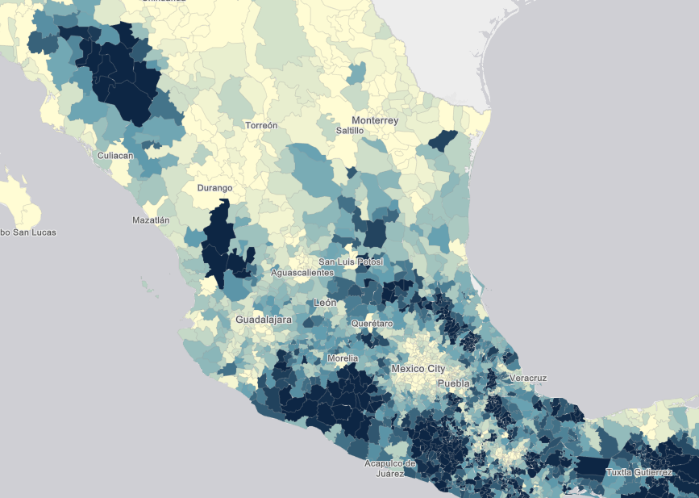
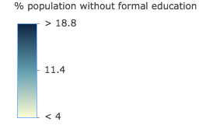
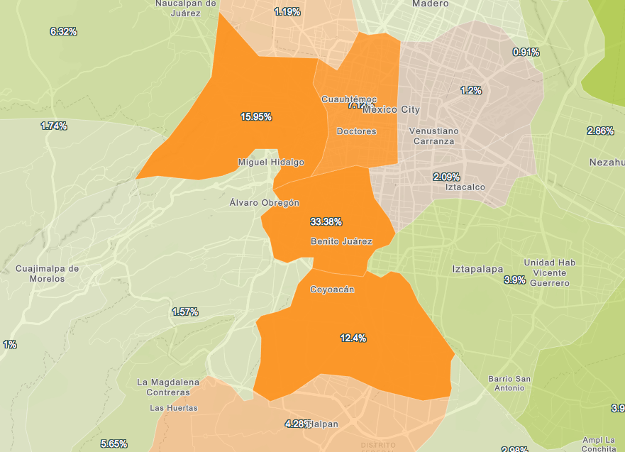
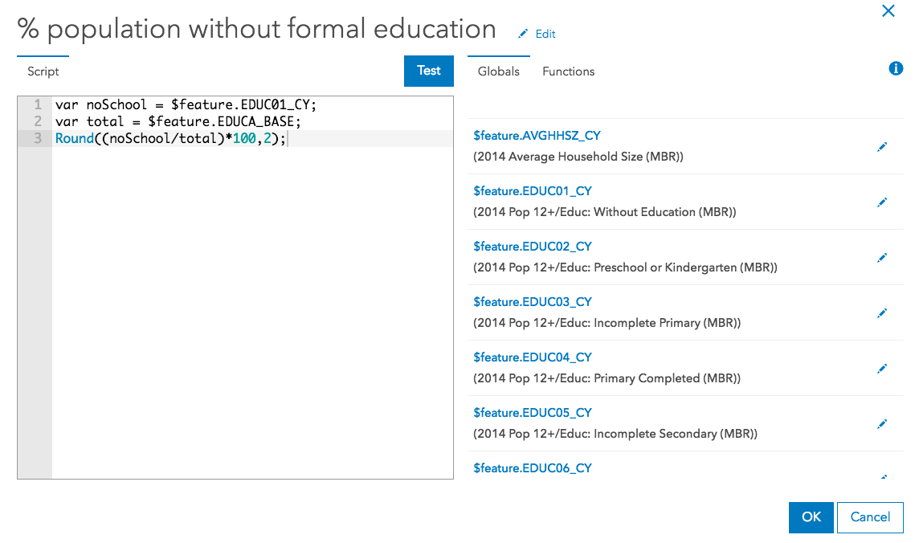
Demos

Slide 28

Arcade and the ESRI JS API
ESRI JS API
Version 3.23
ESRI JS API
Version 4.6
Arcade
Arcade
Inside
Inside
“
Arcade Interpreter available in both 3.23 and 4.6 JavaScript API

Slide 29
ESRI JS API : Arcade Expressions
Arcade Expressions set as Properties
Classes which have Arcade Expressions
ClassBreaksRenderer
UniqueValueRenderer
Visual Variables of Renderers
Color
Size
Opacity
Rotation
Supported for FeatureLayer and SceneLayer

Slide 30
ESRI JS API : Arcade Expressions
var renderer = new ClassBreaksRenderer({
valueExpression: "( $feature.TOT_VOTES / $feature.REG_VOTERS ) * 100",
valueExpressionTitle: "Title to Display"
classBreakInfos: [ ... ],
});
Expression Properties are set as Literal Strings
Arcade Interpreter will Execute valueExpression for every Feature

Slide 31
ESRI JS API : Arcade Expressions in JS API 3.19
Arcade Expressions can be used For Labeling
var labelClass = new LabelClass({
labelExpressionInfo: {
expression: "$feature.STATION_NAME"
},
labelPlacement: "below-right",
minScale: 2500000
});
nameClass.symbol = new TextSymbol();
// set the label class to the feature layer
featureLayer.setLabelingInfo([ labelClass ]);

Slide 32
Practicalities: Scripts in Script
<script type="text/plain" id="myScript">
Proper($feature.CityName)
</script>
...
var arcadescript = document.getElementById(“myScript").text;
Scripts within Scripts
Lots of String Escaping.
Embed Script in HTML using MIME type text/plain

Slide 33
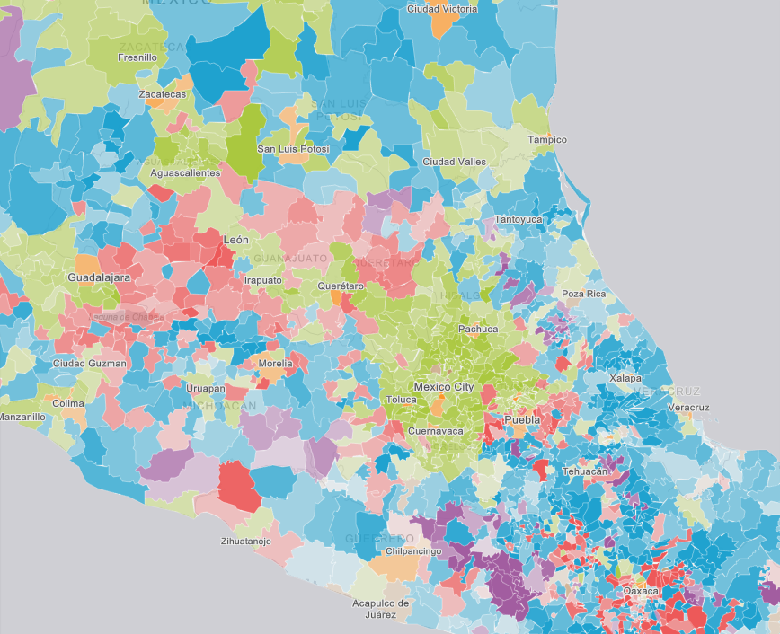
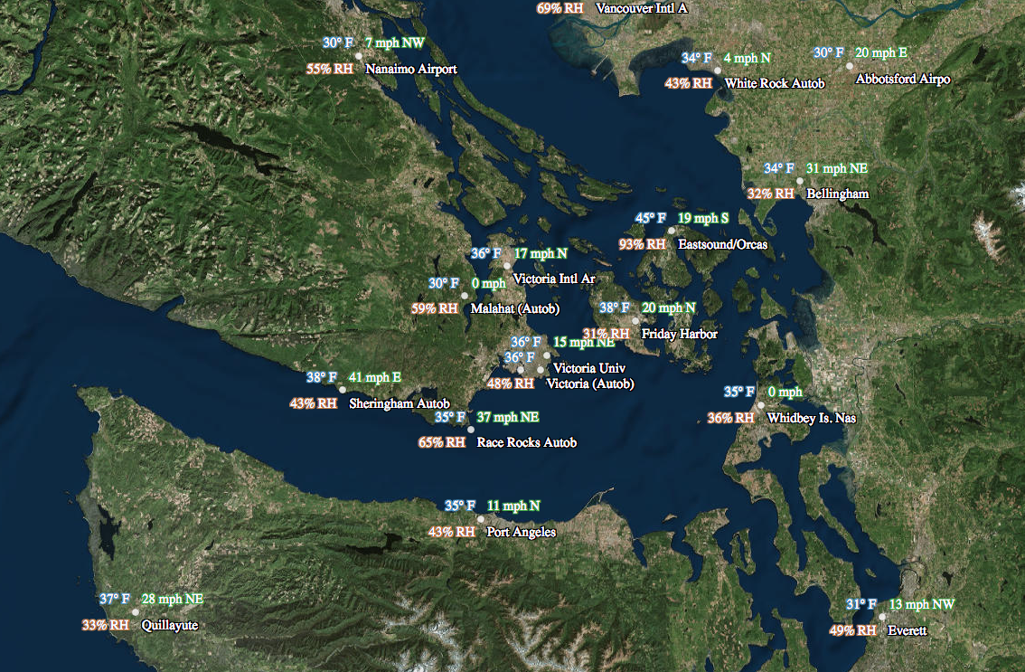
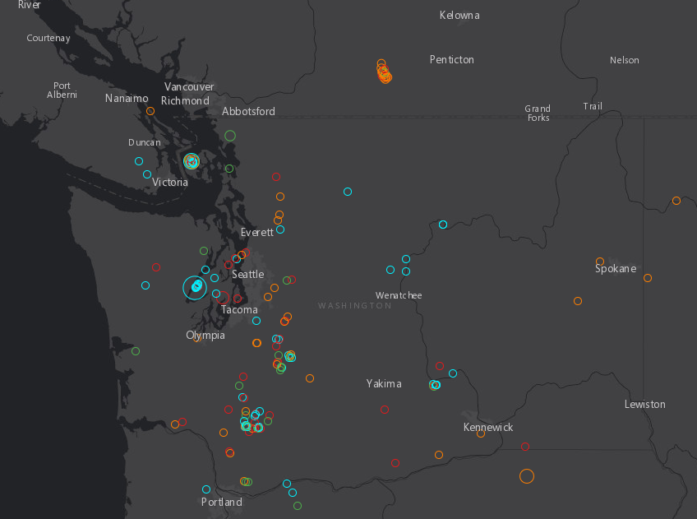
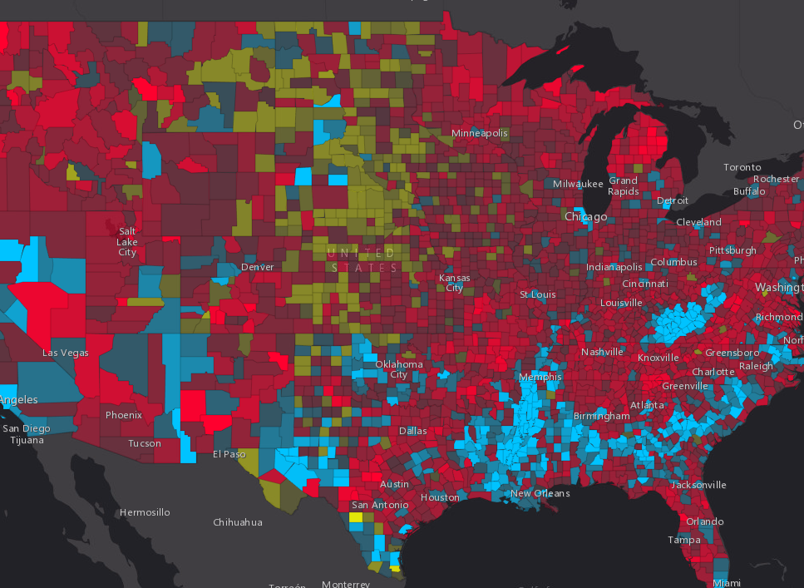
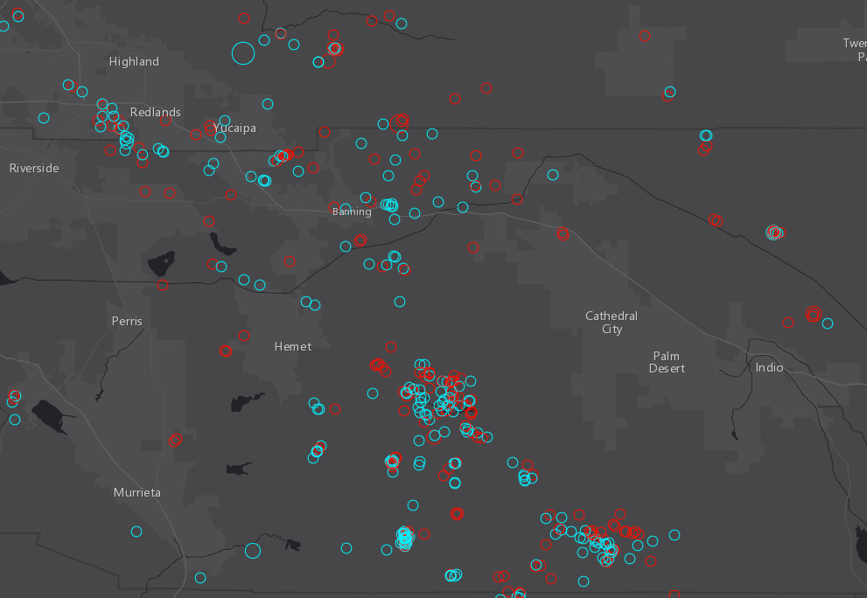
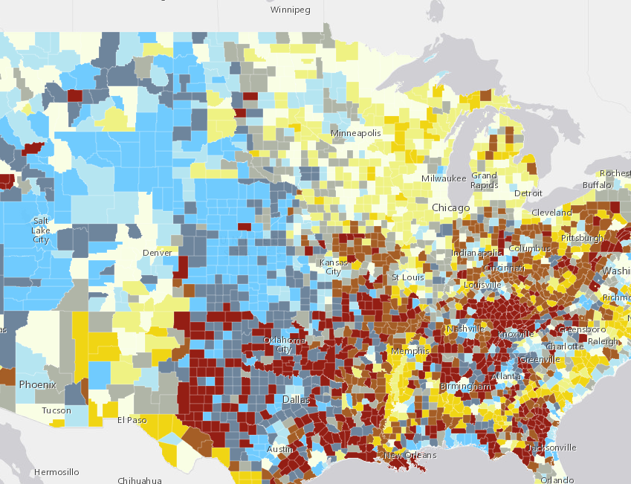
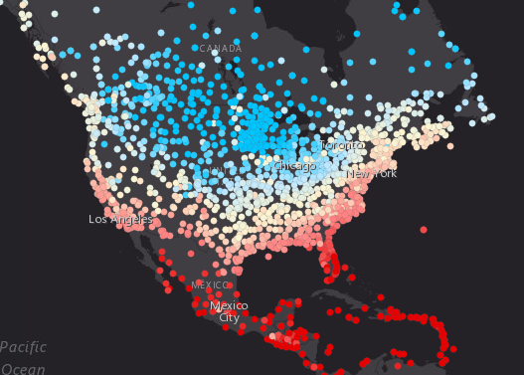
Demos
Programming in ESRI JS API with Arcade

Slide 34
Arcade Interpreter : Inside of JS App using Arcade
Script Parsed into Syntax Tree
Compiled Arcade Script Executed
API Expression Property Set
Result Returned for On Demand Execution
Profile Context Constructed
On Demand Execution of Expression
Script Compiled
Standard Execution Lifecycle of Arcade Script
Script Parsed into Syntax Tree
Arcade Interpreter - Statement by Statement Execution
API Expression Property Set
Result Returned for On Demand Execution
Profile Context Constructed
On Demand Execution of Expression
Browser Restricted Execution of Arcade Script

Slide 35
Future

Slide 36
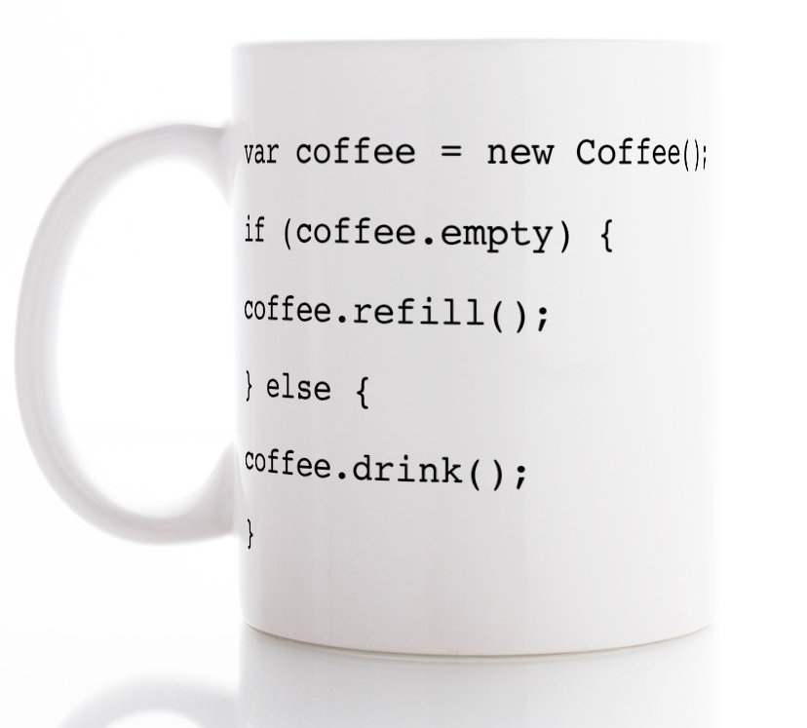
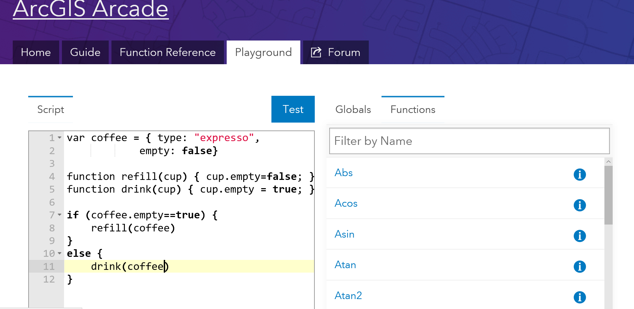
More uses of Arcade
Field Calculators
Pop-ups

Slide 37
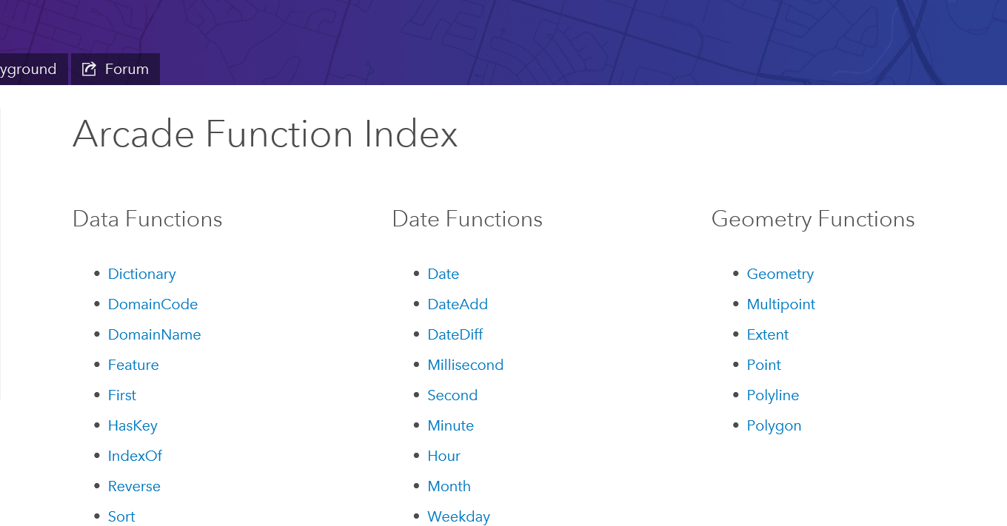
Adding Functions
Identifying Common Operations
Let us know what you need!

Slide 38
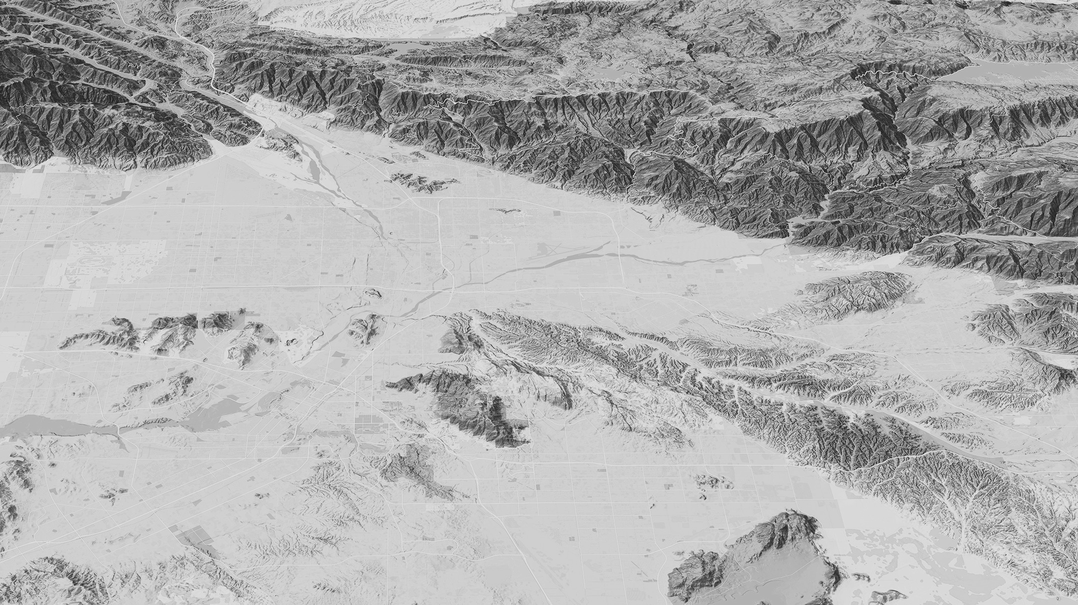

Finding Arcade Resources
Notes:
A big headache with any language or script expression.. Whether it is an Excel Formula, ActionScript, JavaScript or C# is where to find resources.
We have spent a bit of time putting together the help for Arcade online

Slide 39
Resources
For Arcade Documentation
https://developers.arcgis.com/arcade
Playground https://developers.arcgis.com/arcade/playground/
Using Arcade with JS API
https://developers.arcgis.com/javascript/latest/guide/arcade/index.html
Blogs and Posts https://blogs.esri.com/esri/arcgis/2016/12/19/introducing-arcade/
https://blogs.esri.com/esri/arcgis/2016/12/15/use-arcade-expressions-to-map-your-ideas/
http://odoe.net/blog/hello-arcade/
https://blogs.esri.com/esri/arcgis/2017/01/10/using-arcade-expressions-in-web-apps/

Slide 40
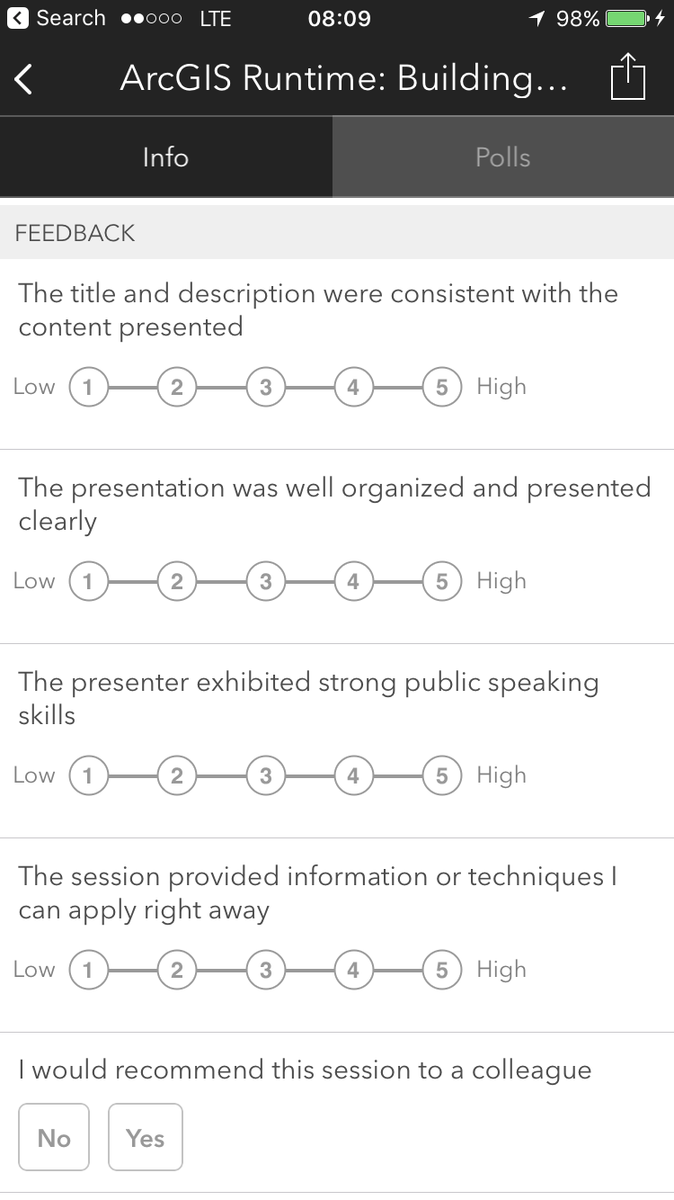
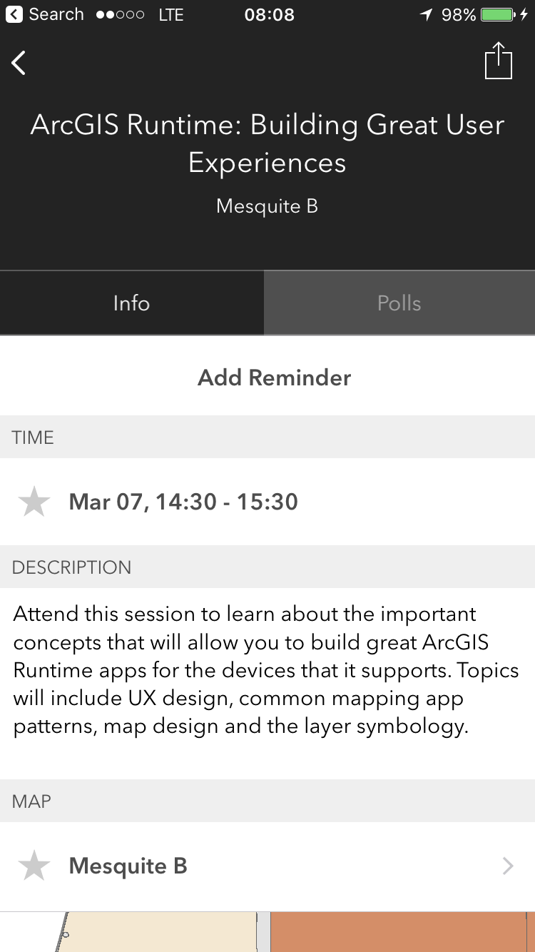

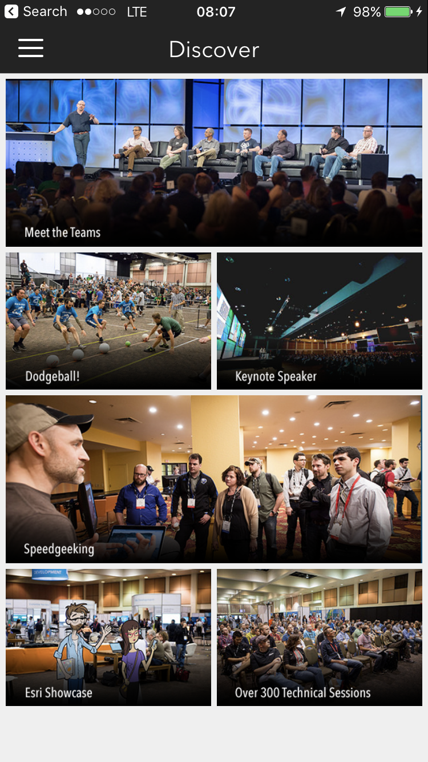
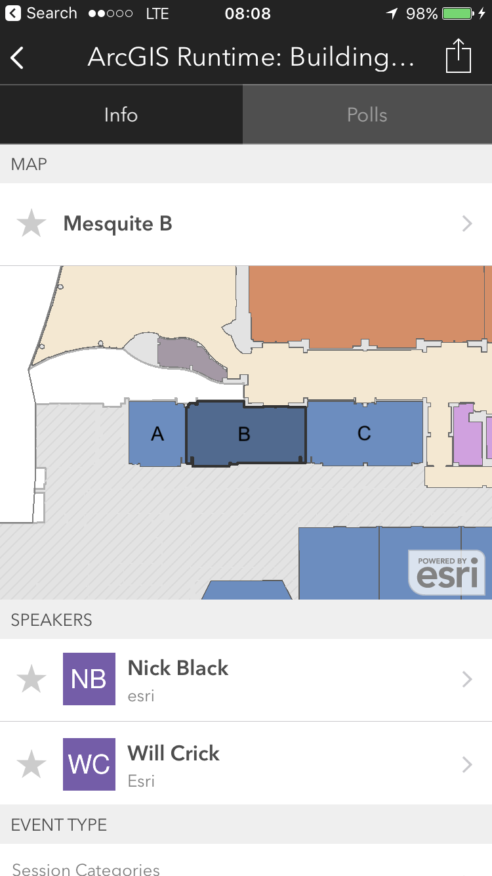
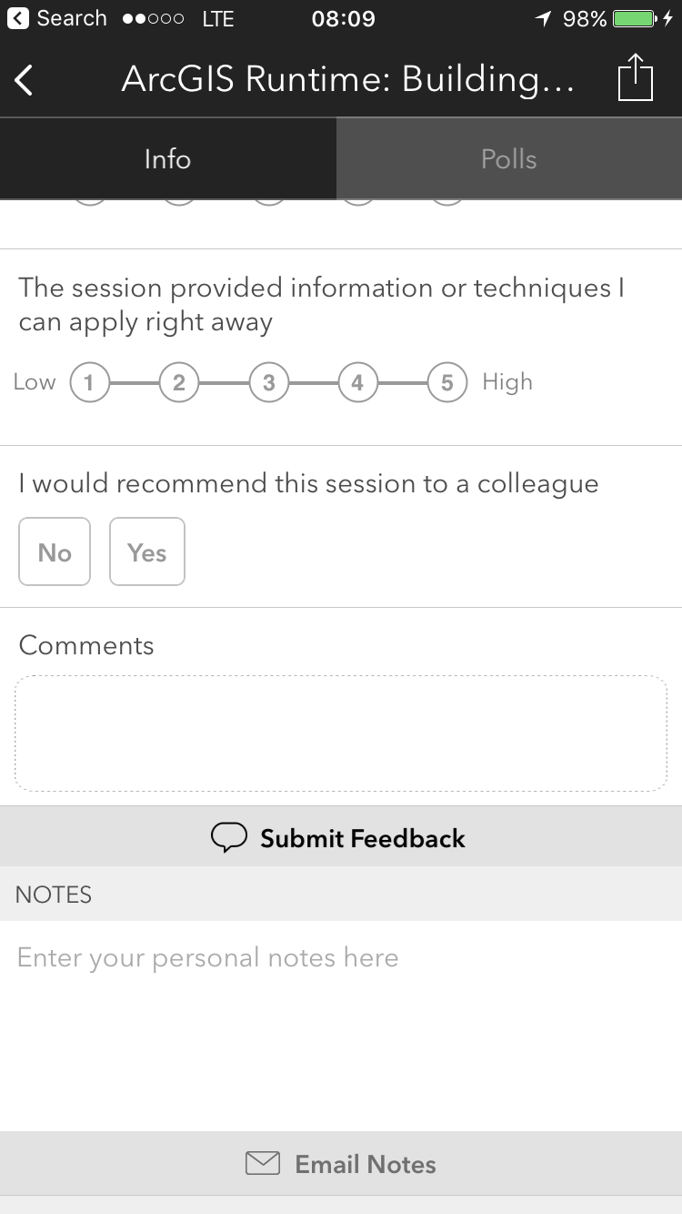
Please Take Our Survey!
Scroll down to the
“Feedback” section
Download the Esri Events app
and go to DevSummit
Select the session you attended
Complete Answers,
add a Comment,
and Select “Submit”

Slide 41



